Slide 1
BRITISH AIRWAYS DATA ANALYSIS
Tam Nguyen
November 27, 2022

Slide 2
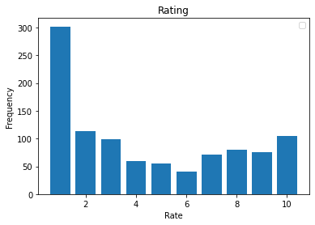
SKYTRAX DATA INSIGHTS
After goes through all the data from Skytrax, I regconize a high volume of low rating. More than 500 out of 1000 data points are negative feedback (which is lower than 5/10).
The rate with highest volume is 1, with approximate 300 responses.
Some classic feedback with rating 1/10:
British Airways is late, their website is atrocious, and they wouldn't let me check-in until 24 hours before the flight. I have been trying for 6 hours to check in through their website, and/or find a real person to speak with. Customer service had such a thick accent I didn't think they were speaking English.
Worst experience ever. Outbound flight was cancelled and I was not notified. I was rebooked on a very uncomfortable trip. Inbound flight delayed 1 hour, also not notified. On top of it, they boarded my hand luggage, which was the only bag I had. Extra wait in Milan then. Food is horrible.
Beyond disgusted with the fact that my baggage has yet to be delivered to me after 5 weeks of emails and calls to BA. Two pieces reported 29th September. BA responses are generic non specific and all attempts to speak to a customer service worker are obstructed. All this from an airline touting its values and claiming yo be one of the best in the world. Disgraceful does not fully describe their customer service.

